Slide 1
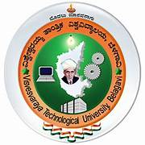

DESIGN THINKING TOOLS APPLIED TO ENHANCE PRECISION IN AGRICULTURE THROUGH AUGMENTED AND VIRTUAL REALITY
Submitted in partial fulfillment for the award of the Degree of
Bachelor of Engineering
in
Computer science and Engineering
By
Chitrashree K 1BM23CS081
Kashvi Agarwal 1BM23CS142
Keerthi Reddy 1BM23CS137
Kanishka Sharma 1BM23CS138
Under the mentorship of
Santosh Somashekhar, Assistant Professor, Department of Mechanical Engineering, BMSCE
Department of Mechanical Engineering,
B.M.S College of Engineering
(Autonomous College under VTU),
Bengaluru- 560019

Slide 2
Contents
Problem Definition
Introduction to AR and VR in Agriculture
Benefits of AR/VR in Agriculture
Innovations adopted
Challenges and Limitations of AR/VR in Agriculture
Future trends and Emerging Technologies
Conclusion
References

Slide 3
EMPATHY
Empathy in the context of using AR and VR in agriculture can be illustrated through several key points:
1. Understanding Farmers' Needs and Challenges:
Field Simulations
Interactive Training
2. Facilitating Knowledge Sharing and Collaboration:
Virtual Farming Communities
Remote Assistance
3. Enhancing Decision-Making:
Data Visualization
Scenario Planning
4. Promoting Sustainable Practices:
Virtual Experiments
Real-Time Monitoring

Slide 4

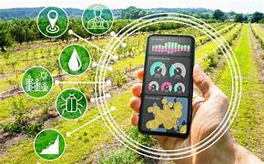
DEFINE
Problem Definition
Traditional agricultural practices often face challenges related
to efficiency, accuracy, and sustainability. Farmers need to
monitor crop health, soil conditions, and irrigation levels across vast fields, a process that is labor-intensive and prone to human error. This problem necessitates innovative solutions to enhance precision agriculture, ensuring optimized resource use and improved crop yields.
Introduction to AR/VR in Agriculture
Fig 1 : Usage of technology on the agriculture field
Immersive technologies like augmented reality (AR) and virtual reality (VR) are transforming traditional agricultural practices by offering unique ways to enhance productivity, efficiency, and sustainability.

Slide 5
What is Augmented Reality (AR)?
AR Explained
AR Applications
AR Tools
Augmented Reality (AR) overlays computer-generated imagery onto the real world, enriching the user's perception and providing valuable information. Imagine seeing real-time data on crop health, pest infestations superimposed on your field of view.
AR can revolutionize tasks like:
AR tools in agriculture provide real-time data overlays for soil health, crop monitoring, and pest detection, helping farmers make informed decisions, optimize resources, and enhance productivity on their land.
Precisely applying fertilizers, and also pesticides
Monitoring, and crop health remotely
Identifying weeds and pests accurately

Slide 6
What is Virtual Reality (VR)?
Virtual reality (VR) is a technology that creates immersive, allowing users to interact with the world through devices like headsets and controllers. VR simulates real or imagined settings, providing a sense of presence and interactivity that can be used for gaming, training, and various applications.
Virtual reality (VR) in agriculture enhances training, research, and farm management. Farmers use VR for immersive training in crop management. It also aids in pest management and allows improving remote assistance and consumer engagement, fostering transparency and efficiency.
VR equipment in agriculture includes headsets for training, interacting with virtual environments, and VR-ready computers. This technology aids in machinery operation training, crop management simulations, farm layout planning, enhancing efficiency and safety.
VR Defined
VR Applications
VR Equipment

Slide 7
Benefits of AR/VR in Agriculture
Enhanced Efficiency
Improved Productivity
1
2
AR/VR can optimize resource allocation and reduce waste by providing real-time data and insights.
By simplifying tasks and providing better decision-making tools, AR/VR can increase crop yields and overall farm productivity.
3
Increased Sustainability
4
Greater Safety
These technologies can help farmers reduce their environmental impact by optimizing resource use and minimizing waste.
AR/VR can improve safety by providing visual warnings and guidance for potentially hazardous tasks.

Slide 8
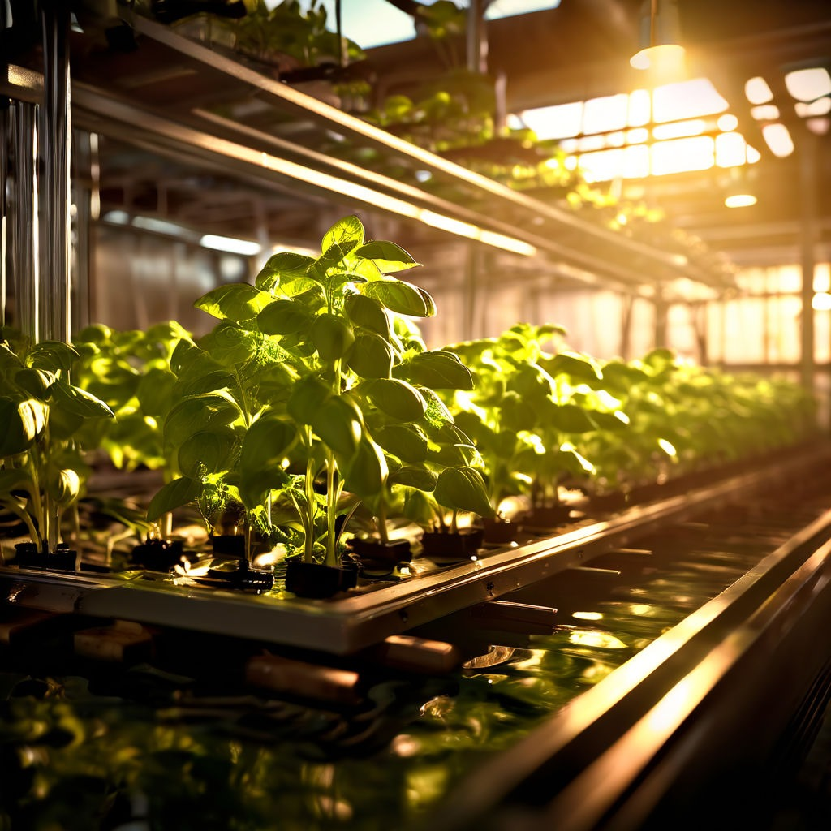



IDEATE AND PROTOTYPE
Phenomics: Understanding the Secrets of Plant Adaptation
Plant Phenotype
Phenomics is the study of how environmental factors influence the physical characteristics and traits of plants.
High-Throughput Screening
AR/VR technologies enable researchers to analyze vast datasets of plant phenotypes, identifying patterns and correlations.
Genetic Modification
Fig 2: Study of plants in semi closed environment
This data helps scientists identify and manipulate genes that contribute to desirable plant traits, leading to improvements in yield, disease resistance, and stress tolerance.

Slide 9
Pusa Farm Sun Bridge and its Salient Features
Feature
Description
The Sun Bridge is equipped with solar panels, providing sustainable energy for the greenhouse.
Solar Panels
Automated systems manage temperature, humidity, and irrigation, optimizing growing conditions.
Automated Control Systems
Sensors monitor plant health, soil conditions, and environmental factors, providing real-time data for analysis.
Advanced Monitoring
The vertical design maximizes space utilization, allowing for increased crop production in a smaller footprint.
Vertical Farming

Slide 10




Hydroponics
Water Conservation
Faster Growth
Nutrient Efficiency
Location Flexibility
Hydroponic systems reduce water usage by up to 90%, compared to the traditional agriculture.
Hydroponics allows plants to grow faster due to optimized nutrient delivery and controlled environments.
Hydroponic systems precisely deliver nutrients to plants, minimizing waste, maximizing absorption.
Hydroponic farms can be located in urban areas, reducing transportation costs and providing fresh produce locally.

Slide 11
Precision Farming and Crop Monitoring
Example Use Cases: 1. Drones with parrot sequoia sensors
2. AR glasses like Microsoft HoloLens
Real-Time Data Analysis
Optimized Resource Allocation
Enhanced Decision-Making
AR overlays can provide real-time information on soil conditions, crop health, and pest infestations.
VR simulations can help farmers optimize resource allocation by visualizing crop growth patterns and identifying areas that require additional water or fertilizer.
AR and VR enable farmers to make informed decisions based on data-driven insights and visualized scenarios.

Slide 12
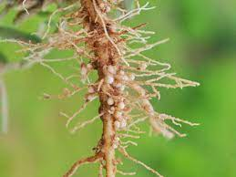
Nematology: Study of Nematodes
Pest Identification
Soil Analysis
AR can be used to identify different types of nematodes, providing valuable information for pest management.
VR simulations can be used to study the impact of nematodes on soil health and crop growth, helping farmers understand and address potential threats.
Fig 3 : Formation of nematodes in the plant roots
Research and Development
AR and VR technologies are being used to accelerate research into new methods for controlling nematode infestations and protecting crops.

Slide 13
Challenges and Limitations of AR/VR in Agriculture
Cost of AR/VR equipment and software can be a significant barrier for many farmers.
High Cost
Access to reliable internet connectivity and technical support is crucial for AR/VR applications in remote agricultural areas.
Limited Accessibility
Ensuring the security and privacy of data collected through AR/VR systems is critical to build trust and adoption among farmers.
Data Privacy Concerns

Slide 14



Future Trends and Emerging Technologies
Drones with AR Integration
Autonomous Agricultural Robots
AI-Powered Decision Support Systems
Drones equipped with AR technology will enable farmers to monitor crops and livestock more effectively, offering real-time insights and data analysis.
AR and VR will play a key role in developing autonomous robots capable of performing a wide range of tasks in the agricultural field, from planting to harvesting.
AI-powered decision support systems will leverage AR and VR to provide farmers with personalized recommendations for optimizing crop yields, managing resources, and improving sustainability.

Slide 15
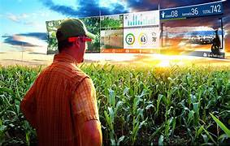
Conclusion
In conclusion, augmented reality and virtual reality offer promising advancements in agriculture, enhancing productivity, efficiency, and sustainability. AR optimizes real-time data for precision farming, while VR provides immersive training and simulation experiences. Embracing these technologies can lead to smarter, more sustainable agricultural practices, shaping a more resilient industry.
Fig 4 : AR VR implementation in the agricultural field

Slide 16
References
Academic Papers and Journals:
"Applications of Augmented Reality and Virtual Reality in General"
Author: X. Liu, Y. Wang, and J. Liu
Journal: Computers and Electronics in Agriculture, 2021.
Summary: This paper explores the use of AR and VR technologies in various agricultural applications, including crop monitoring, training, and resource management.
2. Books:
"Smart Farming Technologies for Sustainable Agricultural Development"
Editor: U. Mukherjee
Publisher: IGI Global, 2021.
Summary: This book covers a range of smart farming technologies, including AR and VR, and their applications in enhancing agricultural productivity and sustainability.

Slide 17
3. Articles and Reports:
"How Augmented Reality Will Transform The Agriculture Practice"
Source: Future Farming, 2020.
Link: Future Farming Article
Summary: An overview of how AR technology is being used in agriculture for real-time data
visualization and decision support.
4. Online Courses and Tutorials:
"Digital Farming: Implementing AR and VR in Agriculture"
Platform: Coursera
Provider: University of Illinois at Urbana-Champaign
Link: Coursera Course
Summary: A course that covers the basics of digital farming technologies, including AR and VR, and their applications in modern agriculture.

